Slide 1


Movie Recommendations
Presented by
Lokesh KATURI
Sreekanth Reddy
VASAVI VEERLA

Slide 2
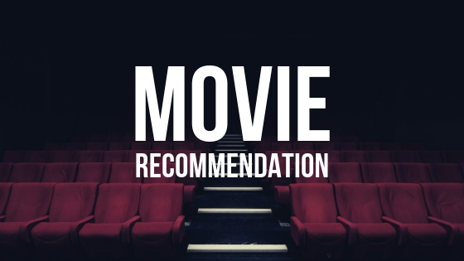
Problem Statement
To understand the trend in the movies and recommend movies based on the similar user experience.

Slide 3
Implementation done in Project
Loading raw data from the data source.
Extract-Load-Transform – Handled Missing Values, Column Datatype Update, Dropped Duplicate Values, Json Column Parsing.
Exploratory Data Analysis- Descriptive Statistics, Profits/Loss correlation with other attributes, Top 10 voted movies, Top 10 movies by budget vs revenue, Top 10 flop movies, Word cloud for movie genre, Movie cast & Director, Director Genre relation, Movies in which Leonardo DiCaprio.
Recommended movies and users using Collaborative Filtering using Alternating Least Squares(ALS).
Built a Tableau dashboard using Transformed Data and Recommended movies and users by Machine Learning.

Slide 4
Original defence proposal
Predicting movie revenue and movie success based on a certain metric
What movies got higher vote counts and vote averages on TMDB?
Building Content Based and Collaborative Filtering Based Recommendation Engines.
We have used the revenue to rate the success of a particular movie.
We have used TMDB vote counts to know the highest success based on TMDB
We have implemented items similarity and collaborative filtering-based recommendations using sparkMLib

Slide 5
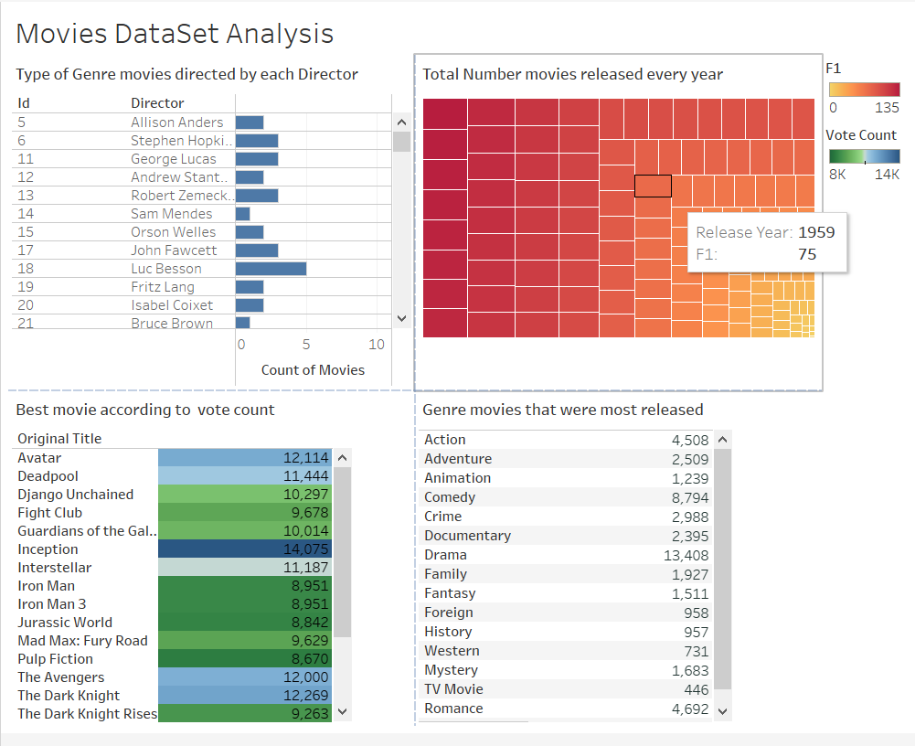
Interpretation of data using Tableau

Slide 6
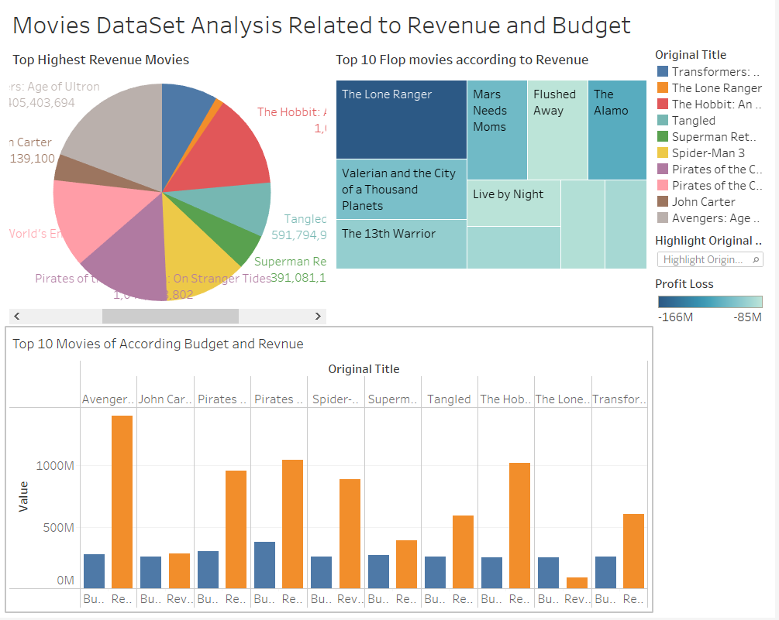

Slide 7
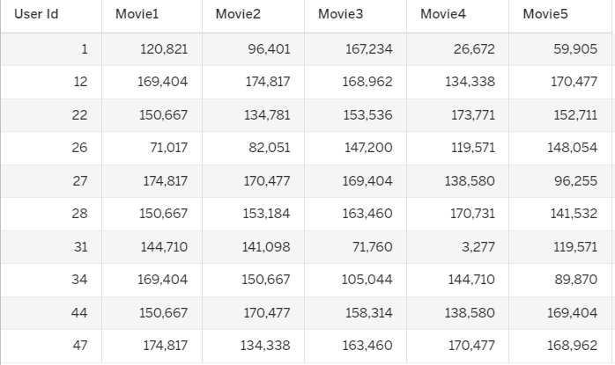
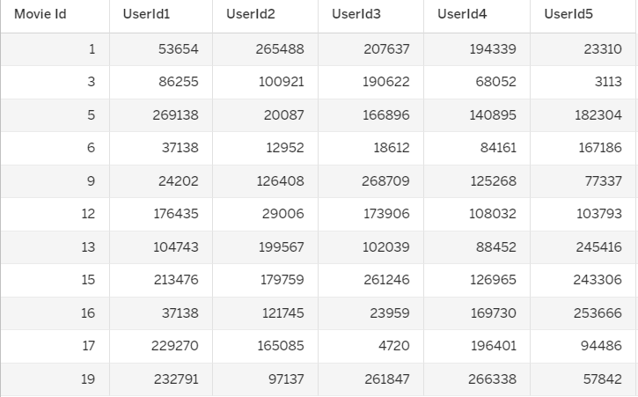
User Recommended for Movies
Movie Recommended for Users
ML: Collaborative Filtering ( Alternating Least Square)

Slide 8
Conclusion
So, we learned how to do analysis and transform data using PySpark .
We Implemented Collaborative filtering using SparkMLib and recommended movies to the users.
We understood how to do configuration between database and BI tools
After completing this project, we understood how to work in Bigdata ecosystem.

Slide 9

Thank You Any Questions?

